Slide 1
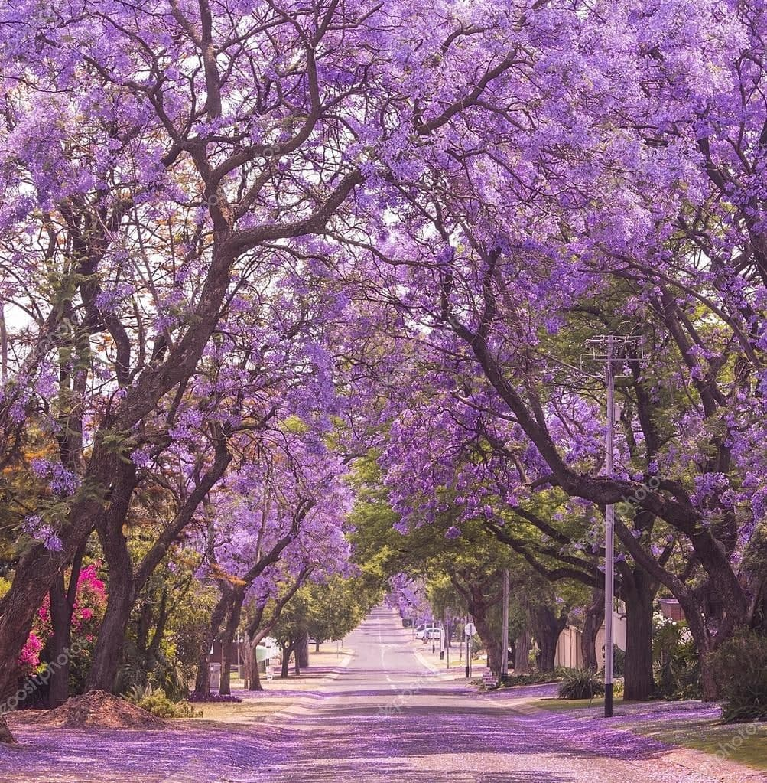
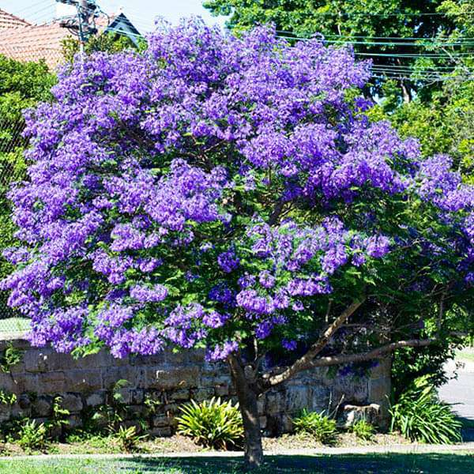
Neelmohar

Slide 2
Common name: Brazilian Rosewood
Scientific Name: Jacaranda mimosifolia
Family: Bignoniaceae
Habit: Jacaranda plants thrive in full sunlight areas. They prefer moderate climates with dry atmospheres and well-drained soils.
Distribution: Jacaranda are also widely common in cities across South Africa. It was introduced to Cape Town, then Johannesburg; Lusaka, Zambia; Botswana; Nairobi, Zimbabwe.

Slide 3
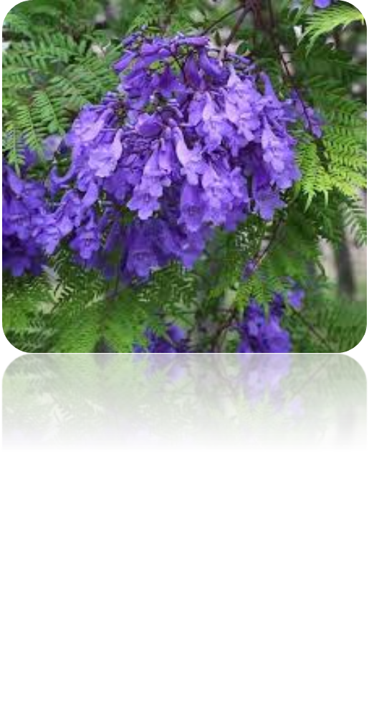
Desccription :
The Jacaranda or Neel Mohar, also known as Brazilian rosewood, blue jacaranda, or blue trumpet tree, is a tropical beauty renowned for its clusters of fragrant, purple, trumpet-shaped blooms. This ornamental tree is often used to beautify avenues and parks, making an excellent shade or street tree.

Slide 4
Uses
All time flowering Tree. Improves air quality and contributes to a healthier environment. helps to stabilize the soil and prevent erosion, especially in sloped areas. Promoting biodiversity in urban areas.
Tradition the flowers, leaves and bark are used to ease neuralgia and varicose veins. qualities that treat leukaemia. Hot Jacaranda leaf baths treat wounds and skin infections, and the tree also helps in the treatment of acne.

